Slide 1
Book Library Project
Monica Lalor, Mikayla Kantorski, Kaleigh Andrzejewski, Angela Gardner
Source Code Website
Project Website

Slide 2

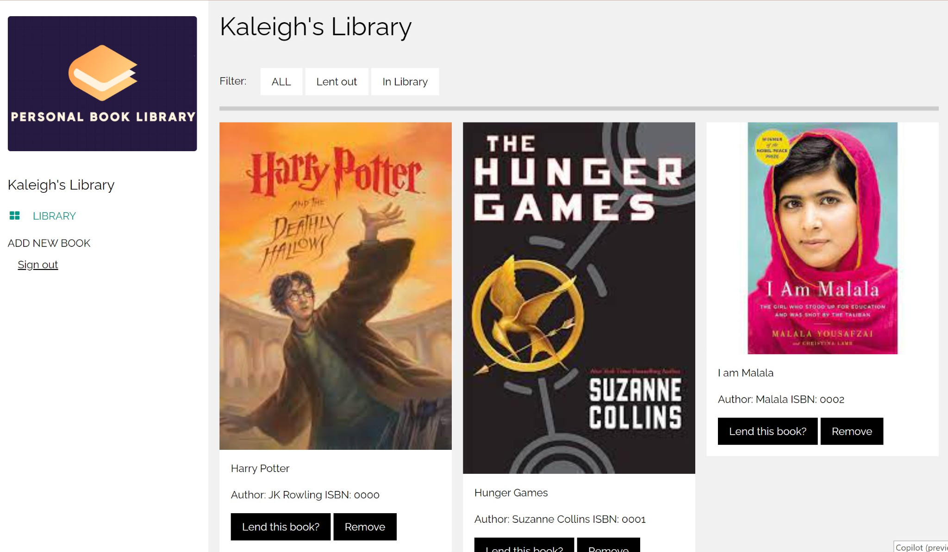
Project Overview
Easily manage the library, track loans, and send email reminders
Create a web interface personal book library where books can be added, removed, and loaned
Notes:
Angela

Slide 3
Sprint Backlog
In Progress
Remove Book Button
Storing Books in database
Storing Renter Info
Email Verification
Finished
Storing Account Information
Add renter Info
Database setup
Edit Status (Frontend)
Add Book (Frontend)
Book Search
Registration Functionality
Login Functionality
Notes:
Monica Lalor

Slide 4


Sprint 1 vs. Sprint 2
Frontend work
Finding/Creating Database
Planning for remainder of project
Connection between frontend and backend
Addition of OpenLibrary API to search for books
Notes:
Mikayla

Slide 5
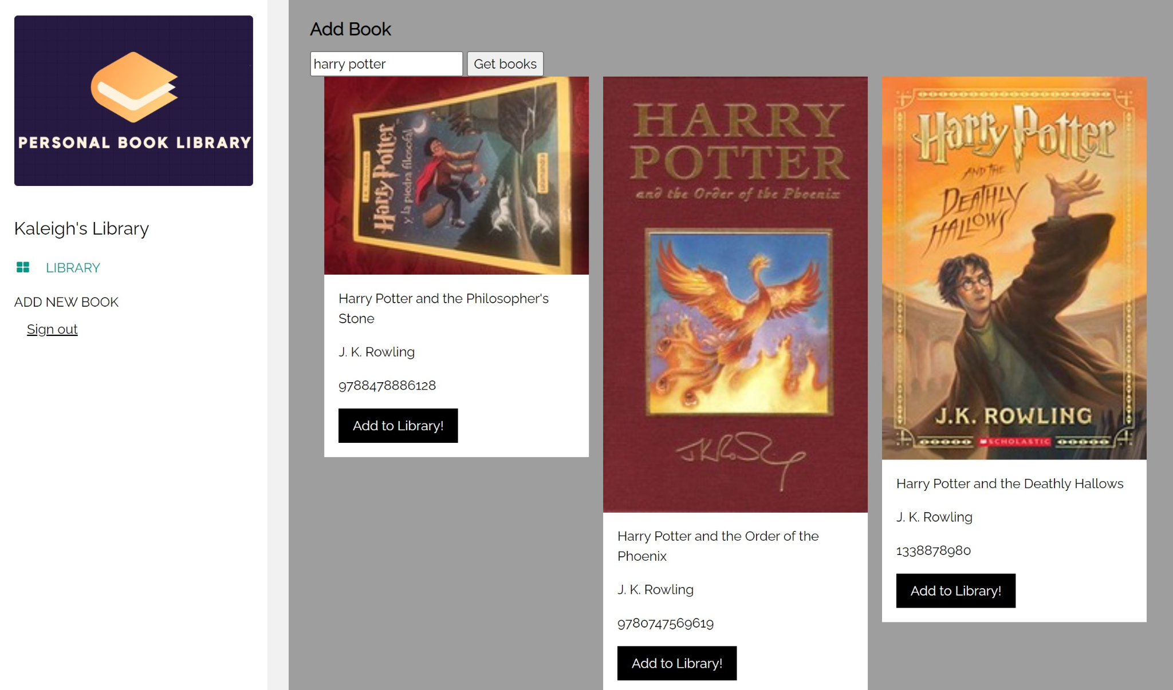
Sprint Reflection
What could be improved:
Team member tasks
Time management
Challenges:
Inexperience in connecting the frontend and backend
Collaboration on backend
What went well:
Adding OpenLibrary API
Search functionality for users
Database connection to frontend
Communication between team members
What didn’t go well:
Frontend and backend connection
Implementation of database into frontend
Notes:
Kaleigh

Slide 6
Contributions
Monica
Search Integration
Edit Book Status
Add Renter information
Mikayla
Frontend functionality and aesthetics
Connection of database
Welcome Page Design
Kaleigh:
Creation of Database
Connection between MySQL database on Javascript code (API)
Login/Registration Functionality
Angela:
Database research
OpenLibrary API code
Book search integration
(Now) Email verification system
Notes:
Everyone do their own contributions

Slide 7
Live Demo!
https://mslalor.github.io/Book-Library-Project/websiteDesignIdeas/login.html
Notes:
Kaleigh

